Slide 1
Training
Code co-occurs much
Code (Python)
There was were 4 pizzas that needed to be shared between 8 people, so I gave each person 1/2
def num_pizza_each( pizzas, people):
return pizzas / people
def cost_for_each_pizza(…
>>> Compute_Pizza(4,8)
>>> 1/2
1. Pretraining documents are conditioned on latent concepts (e.g. Addition, Subtraction)
Concept
(e.g. Division)
Inference
If I had 4 apples and gave each person equal amount, how much does each person have?
2. Sample examples conditioned on previous examples and the inferred concept
def num_pizza_each…
If I had 4 apples and two people an equal amount each, how much does each person have?
Prompt
Well, I remember 4 pizzas divided by 8 people is 1/2
def cost_each_for_pizza
Concept
(e.g. Division)
Like the pizzas, I remember splitting the bill
def divide_apples(apples, people)
Chain of Thought
3. Chain of thought helps infer the right concept
Ah yes! We are talking about division.
>>> divide_apples(4,2)
>>> 2
So four divided by two is two.
Answer

Slide 2


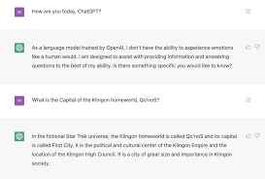
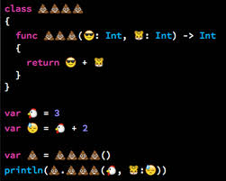


Slide 3
Input
Thought Generation
Thought Execution
NL Prompt
NL Thought
NL Reasoning
Ans
Arm 1
(LLM generates)
(LLM executes)
Sec 3.2
NL vs Code
NL Prompt
Code Thought
Code Simulation
Ans
Arm 2
(LLM generates)
(LLM executes)
Arm 2.5
Prompt Hidden
Code Thought
Code Simulation
Ans
Sec 3.1
excluded from LLM
(only LLM input)
(LLM executes)
LLM vs Ext
Prompt Hidden
Code Thought
Code Execution
Arm 3
not needed
(given to runtime)
(external runtime)
Ans
Tractability: Arm 1→3 hard directly. 3.2) Arm 1↔2, same executor + 3.1) Arm 2.5↔3, same context).

Slide 4
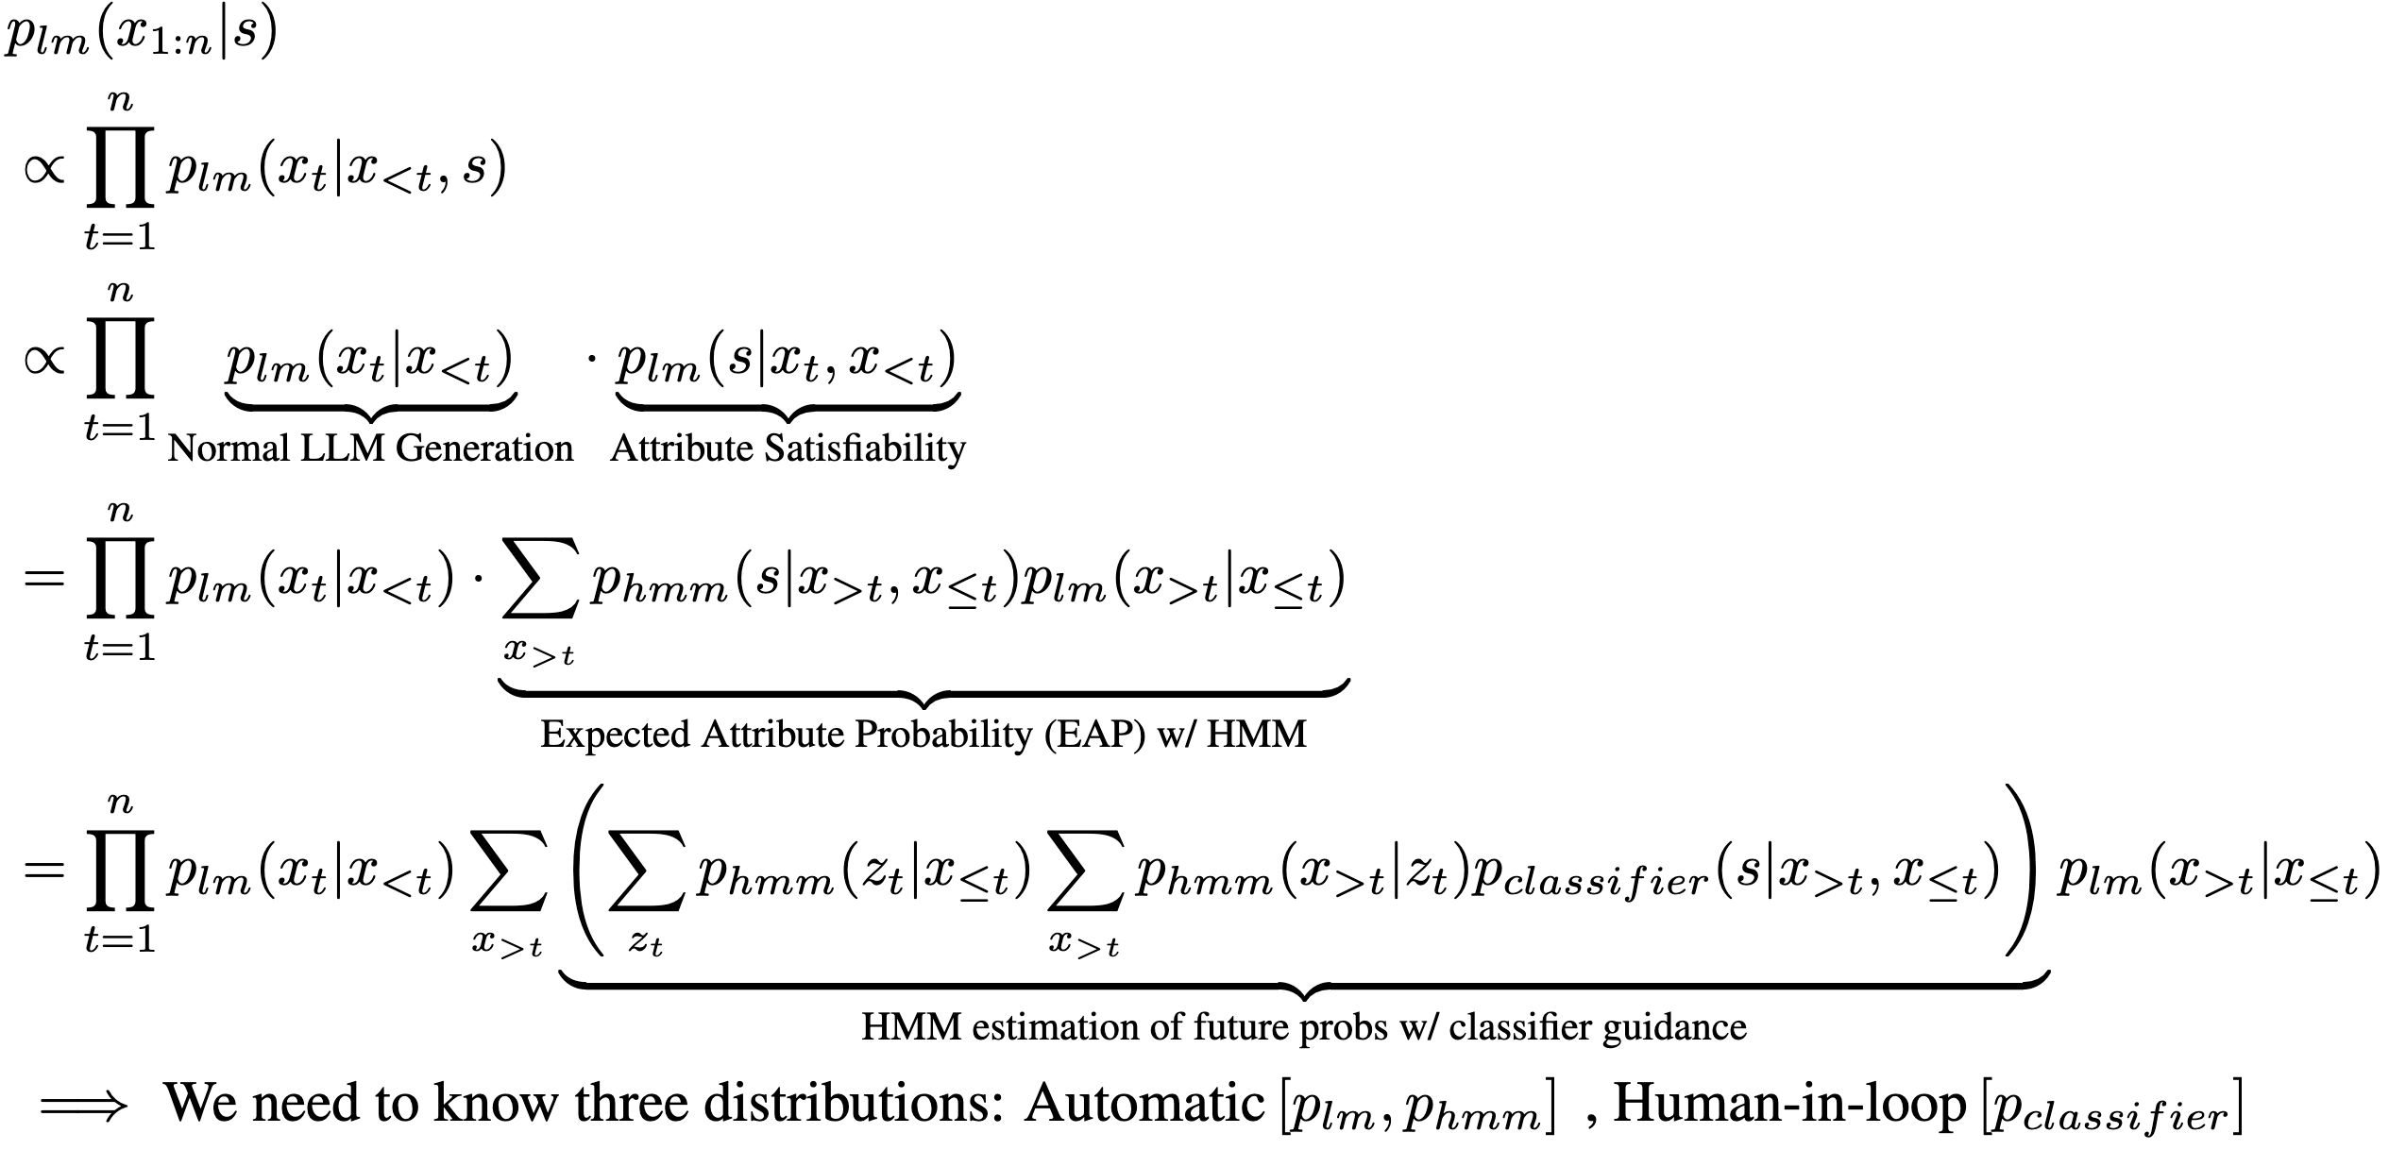

Language Models + HMM Dual
External Utility Estimator
(Plug and Play)
Autoregressive LLM Inference of generating code for tool X, given constraint S
Automatic Learning
Human-in-loop
Efficient
Verifiable
Easy to Integrate
LLM ‘A’ (e.g. ChatGPT)
HMM Distilled
from LLM ‘A’
Tractable Probabilistic Circuit:
Assigns probability 0 to unsatisfiable constraints

Slide 5


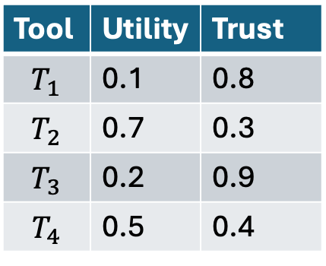



Tools / Entities in environment
Adversary Corruption
Tool | Utility | Trust
$$T_{1}$$ | 0.1 | 0.8
$$T_{2}$$ | 0.7 | 0.3
$$T_{3}$$ | 0.2 | 0.9
$$T_{4}$$ | 0.5 | 0.4
$$T_{1}$$
$$T_{2}$$
How to reason over tools?
Agent
$$T_{3}$$
$$T_{4}$$

Slide 6






Suppose sequence of decisions is of length 3, (either token generation of tool descriptions, or where X directly represents a tool). We just say X is a tool.
Marginal Queries at $T=3⇒P\left(S\right|X_{5}, X_{4}, X_{3}, X_{2} = A, X_{1} = B)$
$$S$$
x
x
x
Output Decision
$$X_{1}$$
+
x
+
x
+
$$X_{2}$$
x
x
+
x
$$X_{3}$$
$$X_{4}$$
$$X_{5}$$
Marginalize over future sequences

Slide 7










The only advantage LM confers is recovery here
Suppose we fail here
$$P\left(z_{code} | x\right)$$
$$P\left(y | z_{code},x\right)$$
Answer $y$
NL Input $x$
Code CoT $z_{code}$
$$P\left(z_{code} | x\right)$$
$$y=Solver(z)$$
Answer $y$
NL Input $x$
Code CoT $z_{code}$
$E_{code}\left[p\left(LM | code\right)−p\left(Solver | code\right)\right]<0$ from the data.
$p\left(Code Wrong\right) ×[p\left(LM Exec Right|Code Wrong\right)−p\left(Solver Right \right|Code Wrong)]$
$p\left(Code Right\right) ×[p\left(LM Exec Right|Code Right\right)−p\left(Solver Right \right|Code Right)]$

Slide 8
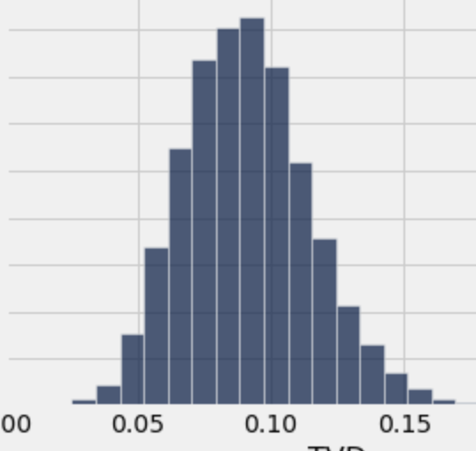
Latents are Identifiable.
P(z| theta, x, r_i = code)
Concept Θ (Addition)
For generating a piece of code: e.g. def add(). For different semantics, the probability of generating this is definitely different (high for addition, low for subtraction)
Concept Θ’ (Addition)
P(z| theta’, x, r_i = code)
P(z| theta, x, r_i = nl)
Concept Θ (Addition)
1. Are we subtracting from Mary, or adding to John?
E.g. Mary Gives John 5 Applies.
Concept Θ’ (Subtract)
P(z| theta’, x, r_i = nl)

Slide 9
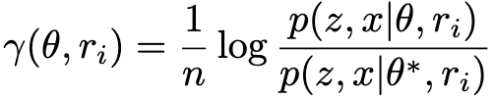
1. Given identifiability of z, we want to show that log likelihood concentrates on the right concept in the limit
1 iff theta is the right answer, otherwise 0
via Asymptotic Equipartition Property of Ergodic Process.
(i.e. generalized Shannon-Mcmillan-Breiman Theorem)

Slide 10
Observed States
def
compute
_amount
_pizza
()
1
2
3
4
5
Hidden States
each transition parameterized by Θ ~ Dirichlet(a), moreover (1) each transition has non-zero probability. (2) we have a finite number of states (3) at least 1 self-loop

